Slide 1
CSE477
VLSI Digital Circuits
Fall 2002
Lecture 20: Adder Design
Mary Jane Irwin ( www.cse.psu.edu/~mji ) www.cse.psu.edu/~cg477
[Adapted from Rabaey’s Digital Integrated Circuits, ©2002, J. Rabaey et al.]

Slide 2
Review: Basic Building Blocks
Datapath
  Execution units
    Adder, multiplier, divider, shifter, etc.
  Register file and pipeline registers
  Multiplexers, decoders
Control
  Finite state machines (PLA, ROM, random logic)
Interconnect
  Switches, arbiters, buses
Memory
  Caches (SRAMs), TLBs, DRAMs, buffers

Slide 3
The 1-bit Binary Adder
C_{in}
A | B | C_{in} | C_{out} | S | carry status
0 | 0 | 0 | 0 | 0 | kill
0 | 0 | 1 | 0 | 1 | kill
0 | 1 | 0 | 0 | 1 | propagate
0 | 1 | 1 | 1 | 0 | propagate
1 | 0 | 0 | 0 | 1 | propagate
1 | 0 | 1 | 1 | 0 | propagate
1 | 1 | 0 | 1 | 0 | generate
1 | 1 | 1 | 1 | 1 | generate
A
1-bit Full Adder
(FA)
S
B
C_{out}
G = A&B
P = A ⊕ B
K = !A & !B
S = A ⊕ B ⊕ C_{in}
C_{out} = A&B | A&C_{in} | B&C_{in} (majority function)
= P ⊕ C_{in}
= G | P&C_{in}
How can we use it to build a 64-bit adder?
How can we modify it easily to build an adder/subtractor?
How can we make it better (faster, lower power, smaller)?
Notes:
A VERY common operation - so worth spending some time trying to optimize
And often in the critical path, so need to look at both
logic level optimizations
circuit level optimizations

Slide 4
FA Gate Level Implementations
The way you learned to design in CSE271 and CSE471
A
B
C_{in}
A
B
C_{in}
t1
t0
t2
t1
t2
t0
C_{out}
C_{out}
S
S
Notes:
AND/XOR/OR adder
but would have to map to CMOS gates, so …
10 gates - 12 + 20 transistors
build xor with NOR feeding or input of an AOI21 gate for a count of 10t
remember or with inverters on inputs is really a nand
4 gate delays to sum out
4 gate delays to carry out
max fan-out of 3 gates on x, y and cin
static CMOS complex gate adder
3 gate delays to sum out
2 gate delays to cout
max fan-in or 2 (no more than 2 transistors in series in any gate)
8 gates - 40 transistors
fan-out of 3 gates for t1, x and y, 4 gates for cin

Slide 5
Review: XOR FA
C_{in}
A
B
S
C_{out}
16 transistors
Notes:
16 transistors – vesterbacke in SiPS99

Slide 6
Review: CPL FA
!B
B
!C_{in}
C_{in}
A
!S
!A
S
B
!B
C_{in}
!C_{in}
A
!C_{out}
B
C_{in}
!A
C_{out}
!B
!C_{in}
20+8 transistors, dual rail – beware of threshold drops
Notes:
20 + 4*2 = 28 transistors

Slide 7
Delay Balanced FA
!P
Identical Delays for Carry and Sum
B
!B
C_{in}
C_{in}
B
P
P
!C_{out}
p
!C_{out}
S
A
A
C_{in}
C_{in}
P
!B
!P
A
A
!P
Sum generation
P
!P
Carry generation
Signal set-up
20+2 transistors
Notes:
Want balanced delays from inputs to both sum and carry outputs to minimize glitching
but notice that !cout is produced – does the inverter to form cout spoil the balance?

Slide 8
Review: Mirror Adder
24+4 transistors
B
6
A
8
B
8
B
8
A
4
B
4
C_{in}
4
A
6
0-propagate
kill
8
A
8
4
C_{in}
6
C_{in}
!C_{out}
!S
4
A
4
2
C_{in}
3
1-propagate
generate
B
B
A
B
C_{in}
A
3
A
4
4
4
2
2
2
B
3
C_{out} = A&B | B&C_{in} | A&C_{in}
SUM = A&B&C_{in} | C_{OUT}&(A | B | C_{in})
Sizing: Each input in the carry circuit has a logical effort of 2 so the optimal fan-out for each is also 2. Since !C_{out} drives 2 internal and 2 inverter transistor gates (to form C_{in} for the nms bit adder) should oversize the carry circuit. PMOS/NMOS ratio of 2.
Notes:
24 + 4 (for C and Sum inverter) transistor Full Adder
No more than 3 transistors in series
Loads: A-8, B-8, Cin-6, !Cout-2
Number of “gate delays” to Sum – 3?

Slide 9
Mirror Adder Features
The NMOS and PMOS chains are completely symmetrical with a maximum of two series transistors in the carry circuitry, guaranteeing identical rise and fall transitions if the NMOS and PMOS devices are properly sized.
When laying out the cell, the most critical issue is the minimization of the capacitances at node !C_{out} (four diffusion capacitances, two internal gate capacitances, and two inverter gate capacitances). Shared diffusions can reduce the stack node capacitances.
The transistors connected to C_{in} are placed closest to the output.
Only the transistors in the carry stage have to be optimized for optimal speed. All transistors in the sum stage can be minimal size.
Notes:
Particularly the diffusion capacitances

Slide 10
A 64-bit Adder/Subtractor
add/subt
C₀=C_{in}
Ripple Carry Adder (RCA) built out of 64 FAs
Subtraction – complement all subtrahend bits (xor gates) and set the low order carry-in
RCA
  advantage: simple logic, so small (low cost)
  disadvantage: slow (O(N) for N bits) and lots of glitching (so lots of energy consumption)
A₀
1-bit FA
S₀
B₀
C₁
A₁
1-bit FA
S₁
B₁
C₂
A₂
1-bit FA
S₂
B₂
C₃
. . .
C₆₃
A₆₃
1-bit FA
S₆₃
B₆₃
C₆₄=C_{out}

Slide 11
Ripple Carry Adder (RCA)
A₃
B₃
A₂
B₂
A₁
B₁
A₀
B₀
C_{out}=C₄
FA
FA
FA
FA
C₀=C_{in}
S₃
S₂
S₁
S₀
T_{adder} ≈ T_{FA}(A,B→C_{out}) + (N-2)T_{FA}(C_{in}→C_{out}) + T_{FA}(C_{in}→S)
T = O(N) worst case delay
Real Goal: Make the fastest possible carry path
Notes:
worst case is when the carry ripples from the least to most significant end

Slide 12
Inversion Property
Inverting all inputs to a FA results in inverted values for all outputs
A
B
A
B
C_{out}
FA
C_{in}
≡
C_{out}
FA
C_{in}
S
S
!S (A, B, C_{in}) = S(!A, !B, !C_{in})
!C_{out} (A, B, C_{in}) = C_{out} (!A, !B, !C_{in})
Notes:
mod 2**n adder means 1111 + 1 = 0000 (ignoring high order carry out)
Note that high order bit (bit 3) is the sign bit – treated as are all other bits (magnitude bits)

Slide 13
Exploiting the Inversion Property
A₃
B₃
A₂
B₂
A₁
B₁
A₀
B₀
C_{out}=C₄
FA’
FA’
FA’
FA’
C₀=C_{in}
S₃
S₂
S₁
S₀
inverted cell
regular cell
Minimizes the critical path (the carry chain) by eliminating inverters between the FAs (will need to increase the transistor sizing on the carry chain portion of the mirror adder).
Now need two “flavors” of FAs
Notes:
eliminates inverters in the carry path
Notice that the mirror adder produces !cout and !sum out in its 28 transistor implementation, so adder for bit 0 is just the mirror adder. Adder bit 1 would be the other flavor of the mirror adder (once again without the inverter on the carry output). Then the two inverters between bit 0 and bit 1 cancel one another. This eliminates all of the inverters in the carry chain.

Slide 14
Fast Carry Chain Design
The key to fast addition is a low latency carry network
What matters is whether in a given position a carry is
  generated G_{i} = A_{i} & B_{i} = A_{i}B_{i}
  propagated P_{i} = A_{i} ⊕ B_{i} (sometimes use A_{i} | B_{i})
  annihilated (killed) K_{i} = !A_{i} & !B_{i}
Giving a carry recurrence of
C_{i+1} = G_{i} | P_{i}C_{i}
  C₁ =
  C₂ =
  C₃ =
  C₄ =
Notes:
For class handout

Slide 15
Fast Carry Chain Design
The key to fast addition is a low latency carry network
What matters is whether in a given position a carry is
  generated G_{i} = A_{i} & B_{i} = A_{i}B_{i}
  propagated P_{i} = A_{i} ⊕ B_{i} (sometimes use A_{i} | B_{i})
  annihilated (killed) K_{i} = !A_{i} & !B_{i}
Giving a carry recurrence of
C_{i+1} = G_{i} | P_{i}C_{i}
  C₁ = G₀ | P₀C₀
  C₂ = G₁ | P₁G₀ | P₁P₀ C₀
  C₃ = G₂ | P₂G₁ | P₂P₁G₀ | P₂P₁P₀ C₀
  C₄ = G₃ | P₃G₂ | P₃P₂G₁ | P₃P₂P₁G₀ | P₃P₂P₁P₀ C₀
Notes:
For lecture
Note that one and only one of the signals pi, gi, and ai is 1
Si = pi xor ci if we use the xor equation for pi

Slide 16
Manchester Carry Chain
Switches controlled by G_{i} and P_{i}
Total delay of
  time to form the switch control signals G_{i} and P_{i}
  setup time for the switches
  signal propagation delay through N switches in the worst case
!C_{i+1}
!C_{i}
G_{i}
P_{i}
clk
Notes:
when clock is low, the carry nodes precharge; when clock goes high if gi is high, ci+1 is asserted (goes low)
to prevent gi from affecting ci, the signal pi must be computed as the xor (rather than the or) of xi and yi which is not a problem since we need the xor of xi and yi for computing the sum anyway
delay is roughly proportional to n**2 (as n pass transistors are connected in series) so usually group 4 stages together and buffer the carry chain with an inverter between each stage

Slide 17
4-bit Sliced MCC Adder
A₃
B₃
A₂
B₂
A₁
B₁
A₀
B₀
clk
& ⊕
& ⊕
& ⊕
& ⊕
G
P
G
P
G
P
G
P
!C₄
!C₀
!C₃
!C₂
!C₁
⊕
⊕
⊕
⊕
S₃
S₂
S₁
S₀
Notes:
Dynamic circuit – impact on clock power and timing (have to allow for precharge time)
Limit of 4 transistors in a row for speed, then have to buffer carry chain

Slide 18
Domino Manchester Carry Chain Circuit
3 3 3 3 3
clk
P₃
P₂
P₁
P₀
C_{i,4}
1
2
3
4
1
2
G₃
2
3
G₂
3
4
G₁
4
5
G₀
5
6
C_{i,0}
clk
!(G₀ | P₀ C_{i,0})
!(G₂ | P₂G₁ | P₂P₁G₀ | P₂P₁P₀ C_{i,0})
!(G₁ | P₁G₀ | P₁P₀ C_{i,0})
!(G₃ | P₃G₂ | P₃P₂G₁ | P₃P₂P₁G₀ | P₃P₂P₁P₀ C_{i,0})
Notes:
Note four pass transistors in series (P3 P2 P1 P0) + Ci,0 and Me of first gate.
Automatically forms all the intermediate carries as well – as shown on animation
Sizing assumes only integer multiples allowed, should pfets all be 3?

Slide 19
Binary Adder Landscape
synchronous word parallel adders
ripple carry adders (RCA) carry prop min adders
signed-digit fast carry prop residue adders adders adders
Manchester carry parallel conditional carry carry chain select prefix sum skip
T = O(N), A = O(N)
T = O(1), A = O(N)
T = O(√N),
A = O(N)
T = O(N)
A = O(N)
T = O(log N)
A = O(N log N)
Notes:
speed versus complexity versus power consumption but have to worry about constants
also have bit (digit) serial adders and asynchronous adders

Slide 20
Carry-Skip (Carry-Bypass) Adder
A₃
B₃
A₂
B₂
A₁
B₁
A₀
B₀
C_{o,3}
FA
FA
FA
FA
C_{i,0}
C_{o,3}
S₃
S₂
S₁
S₀
BP = P₀ P₁ P₂ P₃ “Block Propagate”
If (P₀ & P₁ & P₂ & P₃ = 1) then C_{o,3} = C_{i,0} otherwise the block itself kills or generates the carry internally

Slide 21
Carry-Skip Chain Implementation
block carry-out
carry-out
BP
block carry-in
P₃
P₂
P₁
P₀
!C_{out}
C_{in}
G₃
G₂
G₁
G₀
BP
Notes:
Only 10% to 20% area overhead
Only 2 “gate delays” to produce cout if skip occurs

Slide 22
4-bit Block Carry-Skip Adder
bits 12 to 15
bits 8 to 11
bits 4 to 7
bits 0 to 3
Setup
Setup
Setup
Setup
Carry
Propagation
Carry
Propagation
Carry
Propagation
Carry
Propagation
C_{i,0}
Sum
Sum
Sum
Sum
Worst-case delay → carry from bit 0 to bit 15 = carry generated in bit 0, ripples through bits 1, 2, and 3, skips the middle two groups (B is the group size in bits), ripples in the last group from bit 12 to bit 15
T_{add} = t_{setup} + B t_{carry} + ((N/B) -1) t_{skip} +B t_{carry} + t_{sum}
Notes:
Set up is for forming p’s and g’s
For N bits and N/B chunks each containing B bits

Slide 23
Optimal Block Size and Time
Assuming one stage of ripple (t_{carry}) has the same delay as one skip logic stage (t_{skip}) and both are 1
T_{CSkA} = 1 + B + (N/B-1) + B + 1
t_{setup} ripple in skips ripple in t_{sum}
block 0 last block
= 2B + N/B + 1
So the optimal block size, B, is
dT_{CSkA}/dB = 0 ⇒ √(N/2) = B^{opt}
And the optimal time is
Optimal T_{CSkA} = 2(√(2N)) + 1
Notes:
so if n=32, bopt = 4 bits and Topt = 12.5 stages compared to a ripple-carry adder of 32 or more than 2.5 times faster
And pass chain to implement GP would also argue for no more than 4 bits in a group

Slide 24
Carry-Skip Adder Extensions
Variable block sizes
  A carry that is generated in, or absorbed by, one of the inner blocks travels a shorter distance through the skip blocks, so can have bigger blocks for the inner carries without increasing the overall delay
C_{out}
C_{in}
Multiple levels of skip logic
C_{out}
C_{in}
skip level 1
AND of the first level skip signals (BP’s)
skip level 2

Slide 25
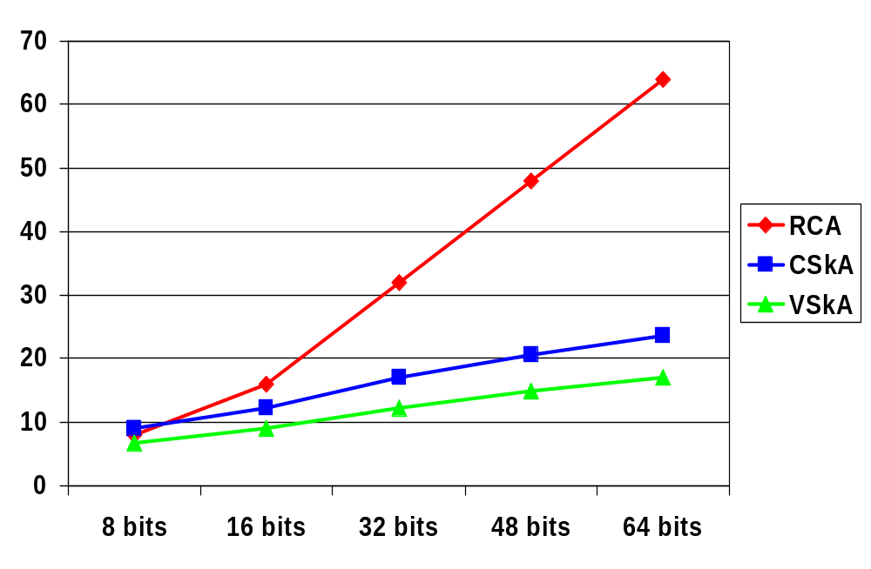
Carry-Skip Adder Comparisons
B=6
B=5
B=4
B=2
B=3
Notes:
Need to redo numbers – just fill in for now!!!

Slide 26
Carry Select Adder
A’s
B’s
4-b Setup
Precompute the carry out of each block for both carry_in = 0 and carry_in = 1 (can be done for all blocks in parallel) and then select the correct one
P’s
G’s
“0” carry propagation
0
“1” carry propagation
1
C_{out}
multiplexer
C_{in}
C’s
Sum generation
S’s
Notes:
“Skip” the carry select adder in lecture – just refer students to the book
Compute both carry out with no carryin and carries with carryin and then select the right one when you know what the real carryin is

Slide 27
Carry Select Adder: Critical Path
bits 12 to 15
bits 8 to 1
bits 4 to 7
bits 0 to 3
A’s
B’s
A’s
B’s
A’s
B’s
A’s
B’s
Setup
Setup
Setup
Setup
P’s
G’s
P’s
G’s
P’s
G’s
P’s
G’s
“0” carry
“0” carry
“0” carry
“0” carry
0
“1” carry
“1” carry
“1” carry
“1” carry
1
C_{out}
mux
mux
mux
mux
C_{in}
C’s
C’s
C’s
C’s
Sum gen
Sum gen
Sum gen
Sum gen
S’s
S’s
S’s
S’s
Notes:
For class handout

Slide 28
Carry Select Adder: Critical Path
bits 12 to 15
bits 8 to 1
bits 4 to 7
bits 0 to 3
A’s
B’s
A’s
B’s
A’s
B’s
A’s
B’s
1
Setup
Setup
Setup
Setup
P’s
G’s
P’s
G’s
P’s
G’s
P’s
G’s
“0” carry
“0” carry
“0” carry
“0” carry
0
+4
“1” carry
“1” carry
“1” carry
“1” carry
1
+1
+1
+1
+1
C_{out}
mux
mux
mux
mux
C_{in}
C’s
C’s
C’s
C’s
+1
Sum gen
Sum gen
Sum gen
Sum gen
S’s
S’s
S’s
S’s
T_{add} = t_{setup} + B t_{carry} + N/B t_{mux} + t_{sum}
Notes:
For lecture
N is number of bits in adder, B is number of bits in block, M is the number of blocks
According to the book, it is easy to show that the carry select adder is more cost effective than the ripple carry adder if n >16/(alpha-1) where alpha is cadd(n) = alpha n for RCAs
For alpha = 4 and tau = 2, the carry select approach is almost always preferable to ripple carry

Slide 29
Square Root Carry Select Adder
bits 14 to 19
bits 9 to 13
bits 5 to 8
bits 2 to 4
bits 0 to 1
A’s
B’s
A’s
B’s
A’s
B’s
A’s
B’s
A’s
B’s
Setup
Setup
Setup
Setup
Setup
P’s
G’s
P’s
G’s
P’s
G’s
P’s
G’s
P’s
G’s
“0” carry
“0” carry
“0” carry
“0” carry
“0” carry
0
“1” carry
“1” carry
“1” carry
“1” carry
“1” carry
1
C_{out}
mux
mux
mux
mux
mux
C_{in}
C’s
C’s
C’s
C’s
C’s
Sum gen
Sum gen
Sum gen
Sum gen
Sum gen
S’s
S’s
S’s
S’s
S’s
Notes:
For class handout

Slide 30
Square Root Carry Select Adder
bits 14 to 19
bits 9 to 13
bits 5 to 8
bits 2 to 4
bits 0 to 1
A’s
B’s
A’s
B’s
A’s
B’s
A’s
Bs
As
B’s
1
Setup
Setup
Setup
Setup
Setup
P’s
G’s
P’s
G’s
P’s
G’s
P’s
G’s
P’s
G’s
0
0
“0” carry
0
“0” carry
“0” carry
“0” carry
“0” carry
0
+6
+5
+4
+3
+2
“1” carry
1
“1” carry
“1” carry
1
“1” carry
“1” carry
1
1
+1
+1
+1
+1
+1
C_{out}
mux
mux
mux
mux
mux
C_{in}
C’s
C’s
C’s
C’s
C’s
+1
Sum gen
Sum gen
Sum gen
Sum gen
Sum gen
S’s
S’s
S’s
S’s
S’s
T_{add} = t_{setup} + 2 t_{carry} + √N t_{mux} + t_{sum}
Notes:
For lecture
Delay balancing – make the later blocks bigger
How about two level carry select as in book?

Slide 31
Parallel Prefix Adders (PPAs)
Define carry operator € on (G,P) signal pairs
  € is associative, i.e.,
  [(g’’’,p’’’) € (g’’,p’’)] € (g’,p’) = (g’’’,p’’’) € [(g’’,p’’) € (g’,p’)]
(G’’,P’’)
(G’,P’)
G’’
G’
€
!G
where
G = G’’ ∨ P’’G’
P = P’’P’
(G,P)
P’’
€
€
€
€
Notes:
Show how carry operator is associate by example
(g’’’,p’’’)op(g’’,p’’) = (g’’’+p’’’g’’,p’’’p’’) and then (g’’’+p’’’g’’,p’’’p’’)op(g’,p’) = (g’’’+p’’’g’’+p’’’p’’g’,p’’’p’’p’)
Thus, they can be grouped in any order
But carry operator is not commutative, since g’’ + p’’g’ is in general not equal to g’ + p’g’’

Slide 32
PPA General Structure
Given P and G terms for each bit position, computing all the carries is equal to finding all the prefixes in parallel
(G₀,P₀) € (G₁,P₁) € (G₂,P₂) € … € (G_{N-2},P_{N-2}) € (G_{N-1},P_{N-1})
Since € is associative, we can group them in any order
  but note that it is not commutative
P_{i}, G_{i} logic (1 unit delay)
Measures to consider
  number of € cells
  tree cell depth (time)
  tree cell area
  cell fan-in and fan-out
  max wiring length
  wiring congestion
  delay path variation (glitching)
C_{i} parallel prefix logic tree
(1 unit delay per level)
S_{i} logic (1 unit delay)

Slide 33
Brent-Kung PPA
G₁₅
p₁₅
G₁₄
p₁₄
G₁₃
p₁₃
G₁₂
P₁₂
G₁₁
p₁₁
G₁₀
P₁₀
G₉
p₉
G₈
P₈
G₇
P₇
G₆
P₆
G₅
P₅
G₄
P₄
G₃
P₃
G₂
p₂
G₁
P₁
G₀
P₀
C_{in}
€
€
€
€
€
€
€
€
€
T = log₂N
€
€
€
€
A = 2log₂N
€
€
Parallel Prefix Computation
€
€
€
€
€
T = log₂N - 2
€
€
€
€
€
€
€
C₁₆
C₁₅
C₁₄
C₁₃
C₁₂
C₁₁
C₁₀
C₉
C₈
C₇
C₆
C₅
C₄
C₃
C₂
C₁
A = N/2
Notes:
For class handout

Slide 34
Brent-Kung PPA
G₁₅
p₁₅
G₁₄
p₁₄
G₁₃
p₁₃
G₁₂
P₁₂
G₁₁
p₁₁
G₁₀
P₁₀
G₉
p₉
G₈
P₈
G₇
P₇
G₆
P₆
G₅
P₅
G₄
P₄
G₃
P₃
G₂
p₂
G₁
P₁
G₀
P₀
C_{in}
€
€
€
€
€
€
€
€
€
T = log₂N
€
€
€
€
A = 2log₂N
€
€
Parallel Prefix Computation
€
€
€
€
€
T = log₂N - 2
€
€
€
€
€
€
€
C₁₆
C₁₅
C₁₄
C₁₃
C₁₂
C₁₁
C₁₀
C₉
C₈
C₇
C₆
C₅
C₄
C₃
C₂
C₁
A = N/2
Notes:
For lecture
We are assuming that co = 0, so c1 = g0 (c1 = g0 + p0c0)
Time = 2*(2logn – 2) + 2 (to form p’s and g’s and final sum) = 4logn - 2
Area = width of n, height of 2logn – 2 carry cells (to form all of the carries) with 2n - 2 - log n total cells
For n=16 as shown -> 1 unit to form p’s and g’s, 2*(2log16-2)=12 units to form carries, 1 unit to form sums = 14 units
n log n RCA BK
8 3 16 10
16 4 32 14
32 5 64 18
64 6 128 22
Regular structure with limited fanin for all gates - only two issues to worry about are fanout (but have room to insert buffers to deal with this) and maximum wire length of n/2 How about power??
Several/many other kinds of recurrence solvers – Kogge-Stone, Elm, and hybrids (see textbook)

Slide 35
Kogge-Stone PPF Adder
G₁₅
P₁₅
G₁₄
P₁₄
G₁₃
P₁₃
G₁₂
P₁₂
G₁₁
P₁₁
G₁₀
P₁₀
G₉
P₉
G₈
P₈
G₇
P₇
G₆
P₆
G₅
P₅
G₄
P₄
G₃
P₃
G₂
P₂
G₁
P₁
G₀
P₀
C_{in}
€
€
€
€
€
€
€
€
€
€
€
€
€
€
€
€
€
€
€
€
€
€
€
€
€
€
€
€
€
€
A = log₂N
T = log₂N
Parallel Prefix Computation
€
€
€
€
€
€
€
€
€
€
€
€
€
€
€
€
€
€
€
€
C₁₆
C₁₅
C₁₄
C₁₃
C₁₂
C₁₁
C₁₀
C₉
C₈
C₇
C₆
C₅
C₄
C₃
C₂
C₁
A = N
T_{add} = t_{setup} + log₂N t€ + t_{sum}
Notes:
add slide on k-s adder

Slide 36
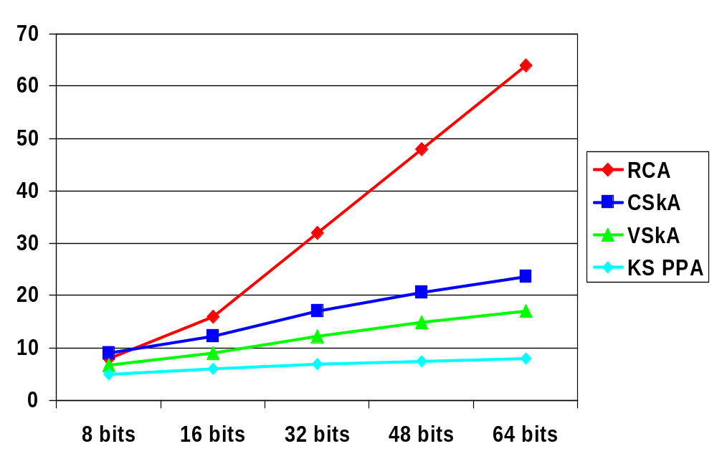
More Adder Comparisons
Notes:
Need to redo numbers – just fill in for now!!!

Slide 37
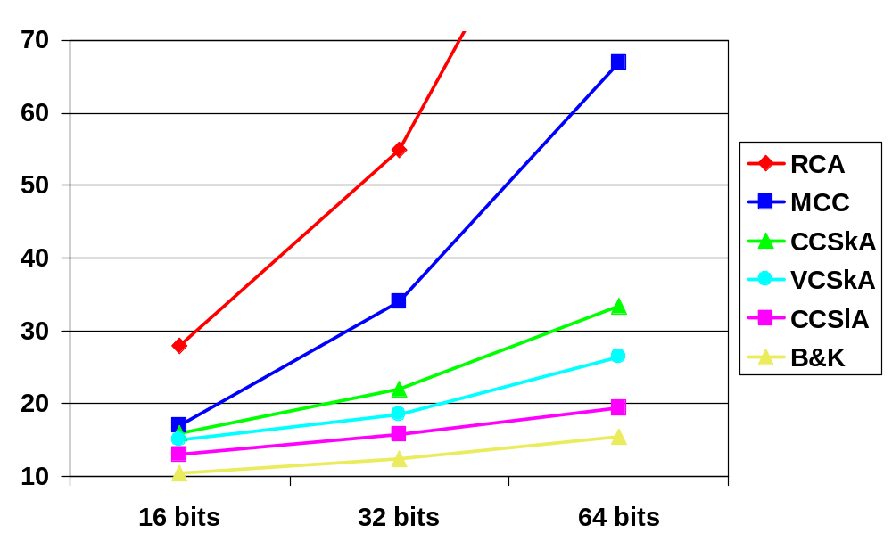
Adder Speed Comparisons
Notes:
From 1999 notes, needs updated
Your mileage may vary

Slide 38
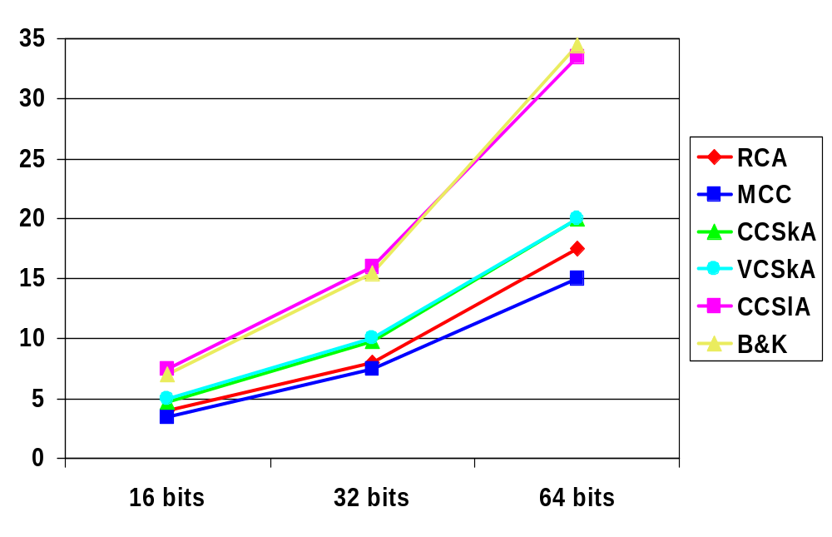
Adder Average Power Comparisons
Notes:
Your mileage may vary

Slide 39
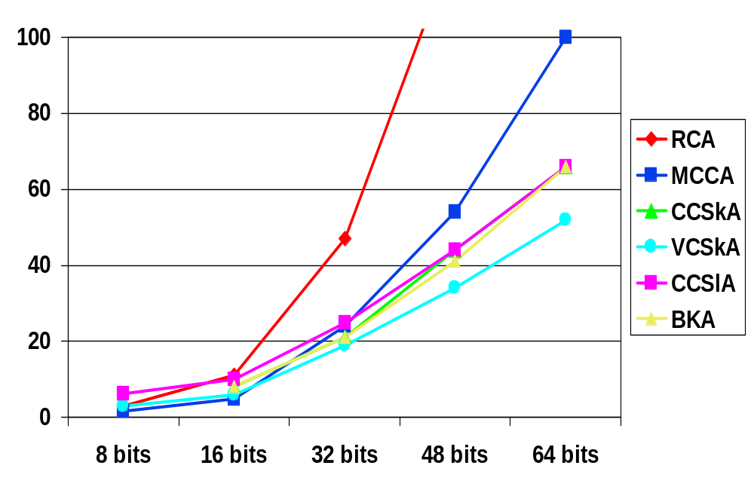
PDP of Adder Comparisons
From Nagendra, 1996

Slide 40
Next Lecture and Reminders
Next lecture
  Multiplier Design
    Reading assignment – Rabaey, et al, 11.4
Reminders
  Project final reports due December 5th
  HW5 (last one!) due November 19th
  Final grading negotiations/correction (except for the final exam) must be concluded by December 10th
  Final exam scheduled
    Monday, December 16th from 10:10 to noon in 118 and 121 Thomas

